Slide 1
Front End Engineering-I Project
Team Details:
PARJOT SINGH{2310992490}
PANKAJ KUMAR {2310992489}
Faculty Coordinator: DR. RATTANDEEP ANEJA
Chitkara University Institute of Engineering and Technology,
Chitkara University, Punjab

Slide 2
Table of Contents
S.NO | CONTENT | SLIDE NO.
1 | INTRODUCTION | 3
2 | PROBLEM STATEMENT | 4
3 | KEY FEATURES | 6
4 | TAG USED | 7
5 | CODE | 9
6 | UI & LINKS USED | 15
7 | CONCLUSION | 16

Slide 3
Introduction
TO-DO LIST MANAGER
GROUP MEMBERS ->
PARJOT SINGH {2310992490}
PANKAJ KUMAR {2310992489}
BRIEF OVERVIEW:-
PURPOSE & GOALS OF TO-DO LIST: A to-do list is a simple tool that helps you organize everything you need or want to do. It can be used for your personal or professional life, or both. A to-do list usually consists of a list of tasks, arranged in order of priority, that you have to complete or plan to do. By writing down your tasks in a to-do list, you can keep track of them, remember them, and focus on the most important ones. ‘You can always change your plan, but only if you have one.’
TASK TRACKING; A to-do list manager's basic duty is to keep track of tasks that have been performed and those that are still unfinished. Users can mark jobs as "done" as they are finished, which inspires and gives a sense of accomplishment. This tracking tool also makes it easier to examine previous activity, which is helpful for performance evaluation.
IMPORTANCE; To-do lists are essential for productivity and task organizing. They provide clarity, set priorities for work, and lessen stress by making sure nothing is overlooked. They promote effective time management, goal achievement, and a feeling of accomplishment.

Slide 4
Problem Statement
STATEMENTS OF PROBLEM:-
PROBLEMS;
We are Human Beings and we make lot of mistakes as well as, we also to finish some important stuff/work and which make lot of troubles.
Task overload: People frequently have a number of duties and responsibilities, which makes it simple to overlook crucial details or feel overburdened by the volume of work at hand.
Task prioritization: Not all tasks are created equal. Users can prioritize chores and concentrate on what must be done first with the aid of a to-do list organizer.
Time management: Time management that works well is essential for productivity. Users that utilize task management tools can better organize their time to various jobs and projects.
Managing deadlines: Tasks often have deadlines, and missing them can have negative effects. Users that utilize a to-do list organizer can keep track of these deadlines and meet them.
Tracking Progress: Users frequently want to see how much progress they've made on assignments and projects. To-do list managers can offer information about completed tasks and general progress.

Slide 5
Technical Details
TECHNOLOGY
TECHNOLOGY:
Basically there are two types of TO-DO LIST 1 is with pen and paper and another one is DIGITAL {here we only talk about digital}
APPLICATIONS; There are many applications for TO-DO LIST one of them is ‘MICROSOFT TODO’.
WEB_LANGUAGES; In this Project we used 3 most popular web languages {HTML,CSS,JAVASCRIPT}. In to-do list the major part is from JAVASCRIPT.
METHODS:
Gamified To-Do Lists: By encouraging users to accomplish activities in exchange for points or incentives, several apps incorporate gamification aspects to make task management more enjoyable and engaging.
BOARDS & KANBAN: Employing the Kanban method to arrange tasks on a board, either real or digital, with columns for "To Do," "In Progress," and "Done." This idea is the foundation of tools like Trello.

Slide 6
Key Features
KEY FEATURES ^{TO-DO LIST}
USER-FRIENDLY- The first and key feature of TO-DO list should be user friendly it have to be good enough that even a baby easily understand it. That’s why we make everything in this project so color full and each task have a unique color {ODD/EVEN}
PRIORITY-LEVELS- In our Project we use the help of ODD/EVEN function in CSS by which we can make a priority level of each task !.
IMPORT TASK: The To-Do- list is not only about text to insert as TASK. It should import numbers. Moreover in our Project if we input some important links in our task it will store the link as it is {not in the form of text}.
Organization: It enables users to categorize tasks, set priorities, deadlines, and reminders, aiding in better organization and time management.
Tracking Progress: Users can track their progress, mark tasks as completed, and visualize their accomplishments, fostering a sense of productivity and achievement.

Slide 7
TAGS USED
To make the To-Do list manager more visually, we used CSS to add styles to the HTML elements. Overall, this To-Do list manager project DEMONSTRATE the use of HTML and CSS as well as JAVASCRIPT to create a effective tool for Todo list manager
HTML:-
The HYPER TEXT MARKUP LANGUAGE or HTML is the standard markup language for documents designed to be displayed in a web browser. It define the meaning and structure of the web page.
CSS:-
CSS stands for Cascading Style Sheets. CSS describes how HTML
elements are to be displayed on screen, paper, or in other media. CSS saves a lot of work.
JAVASCRIPT:-
JS in this project we also use javascript by using (.js) files. Using javascript we can easily add or delete the task from the list and much more

Slide 8
TAGS USED
DIV:-
Tag is used to create a container or a block-level element that allows you to group together other HTML elements and apply styles and attributes to them as a single unit.
SPAN:-
The HTML span element is a generic inline container for inline elements.
DIV CLASSES:-
Tag is commonly used to define styles and apply specific behavior to a group of elements that share a common class name.
META:-
Tag defines metadata about an HTML document. Metadata is information about data.
LINK:-
Tag defines the relationship between the current document and an external resource
UL/OL:-
This tag is used to create a list in HTML, UL=unorder list and OL=ordered list

Slide 9
TAGS USED
Anchor:-
This tag is used to create a link in the HTML/WEBSITE.
IFRAME:-
An inline frame is used to embed another document within the current HTML document
BUTTONS:-
The button tag defines a clickable button. Inside this tag you can put content, like text or images.
ABBR:-
This tag, usually called the abbreviation or acronym tag, is used to show the full form of an abbreviation or acronym on a mouse-over, with its title attribute.
IMAGE:-
This tag is used to insert the image in the webpage

Slide 10
TAGS USED
FOR LOOP:-
A `for` loop in JavaScript is a fundamental control structure used to execute a block of code repeatedly. It consists of three essential parts: initialization, condition, and increment/decrement.
IF/ELSE:-
In JavaScript, the if/else statement is a fundamental decision-making tool that allows for conditional execution of code blocks based on certain conditions. The if statement evaluates a condition and executes a block of code if that condition is true. If the condition is false, and an else block is provided, the code within the else block gets executed
VAR/LET:-
In JavaScript, `var` is used for variable declaration. It's the older way of declaring variables compared to `let` and `const`, which were introduced in newer versions of JavaScript (ES6)

Slide 11
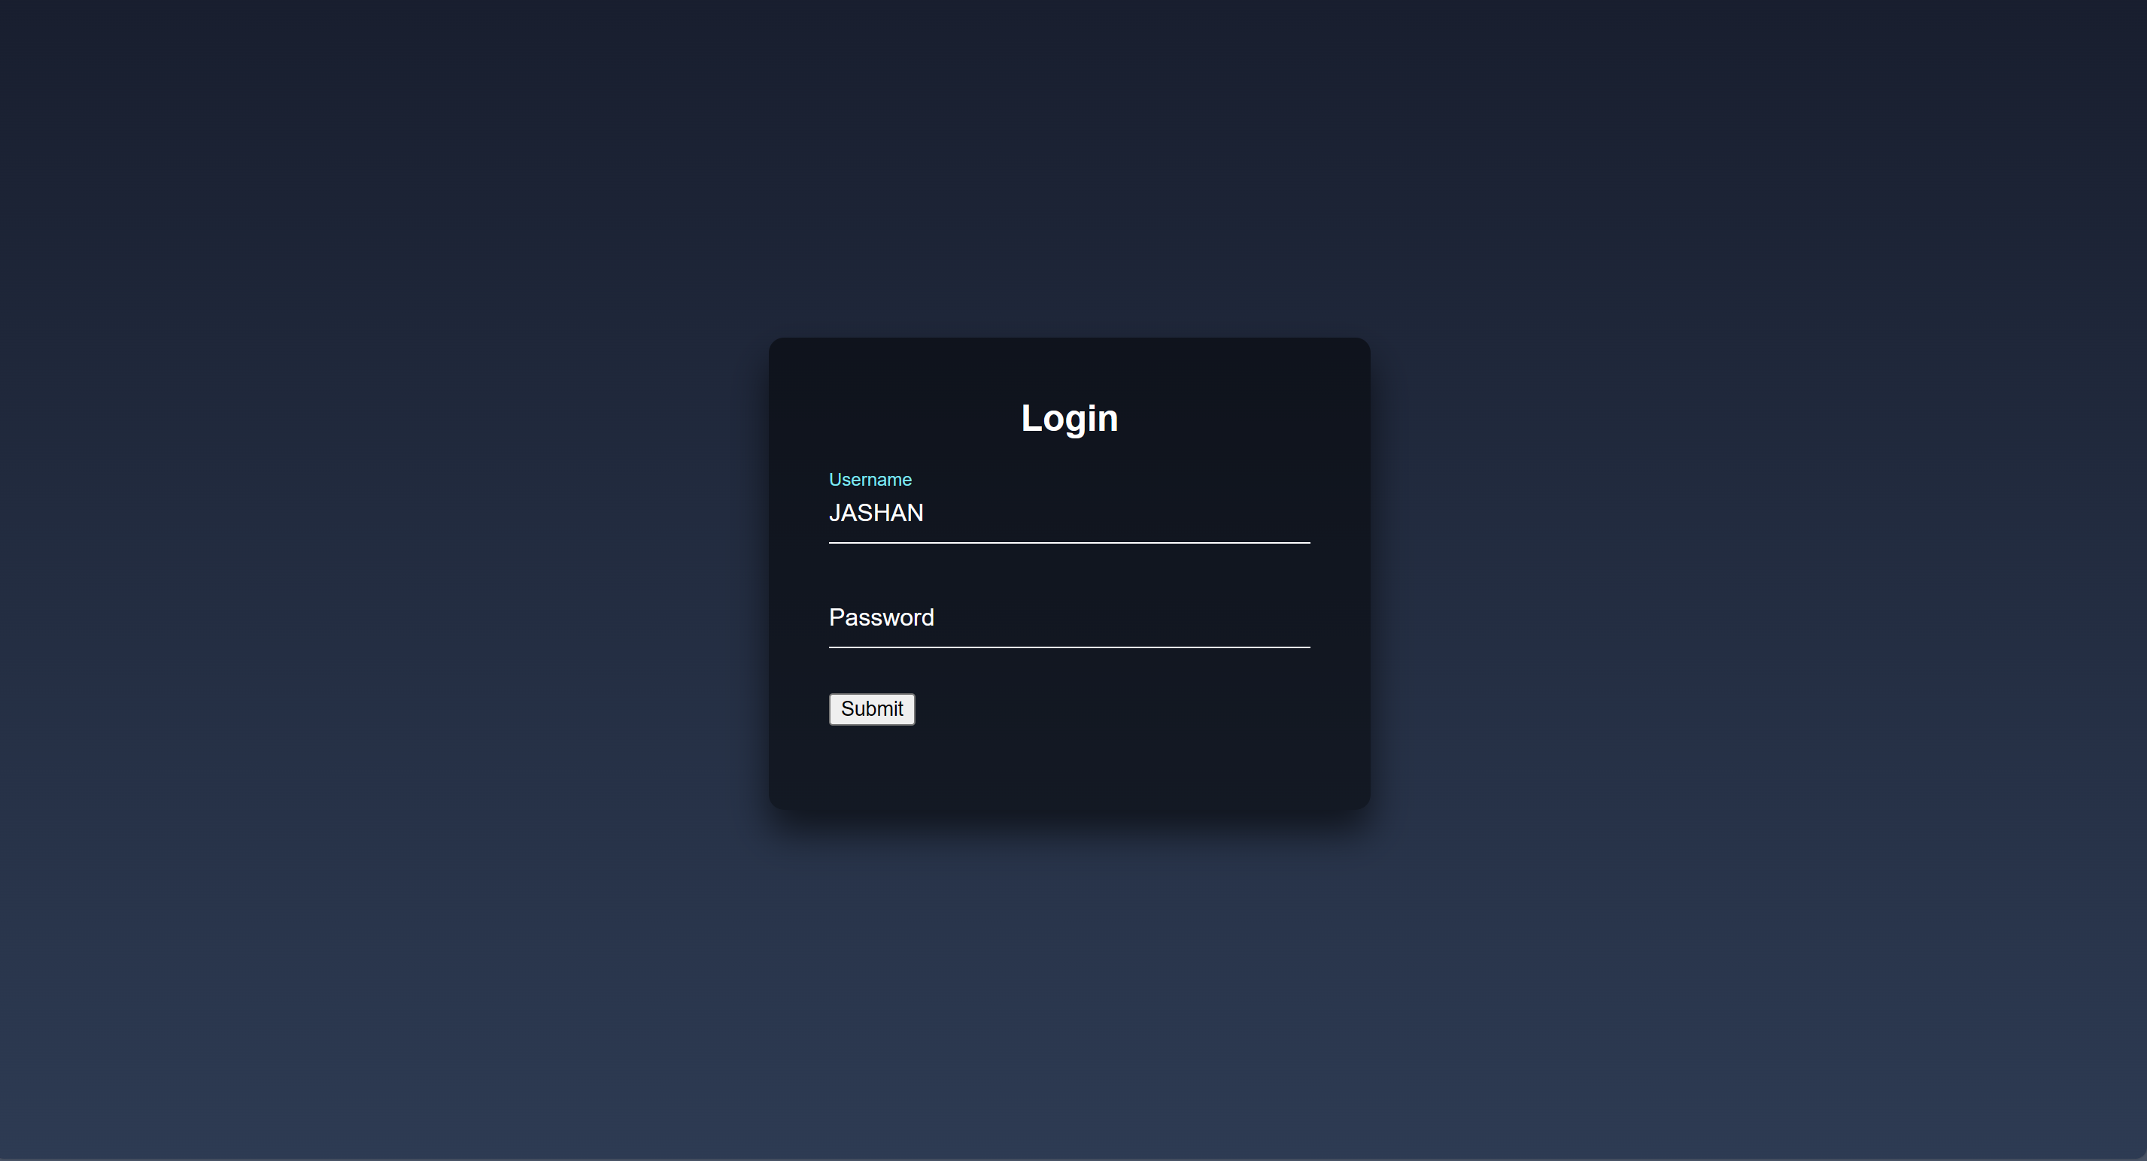
LOGIN PAGE
{using python}

Slide 12
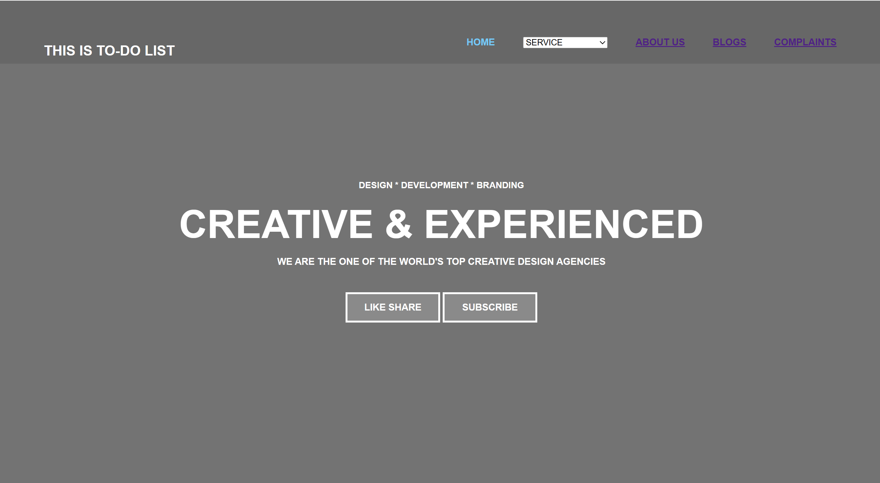
HOME PAGE

Slide 13
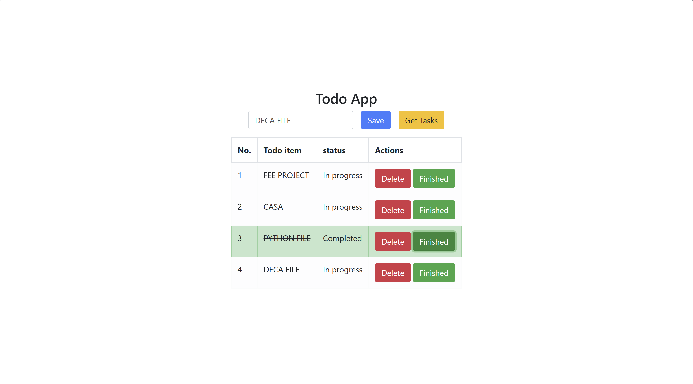
TO-DO LIST

Slide 14
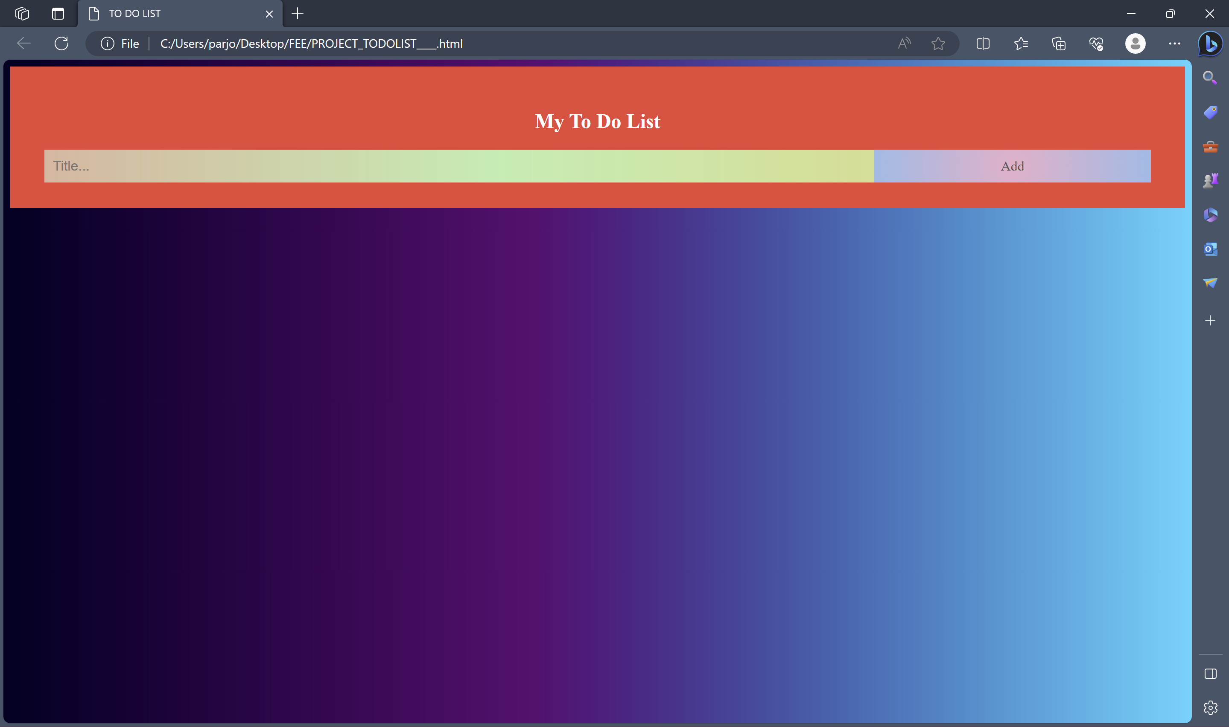
Project Highlights
TODO LIST
HOW TO MAKE OUR PAGE MORE ATTRATIVE:-
Here we use CSS to make our page more attractive and more user-friendly there are many CSS properties, that we used in our project {styling in <body> <ul> <li>}

Slide 15
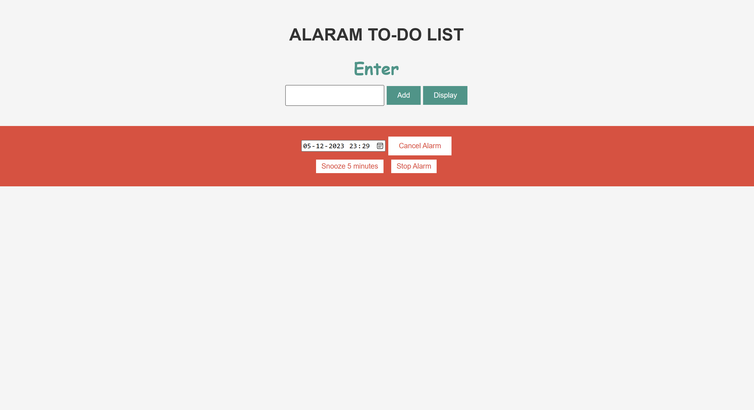
ALARAM TO-DO LIST

Slide 16
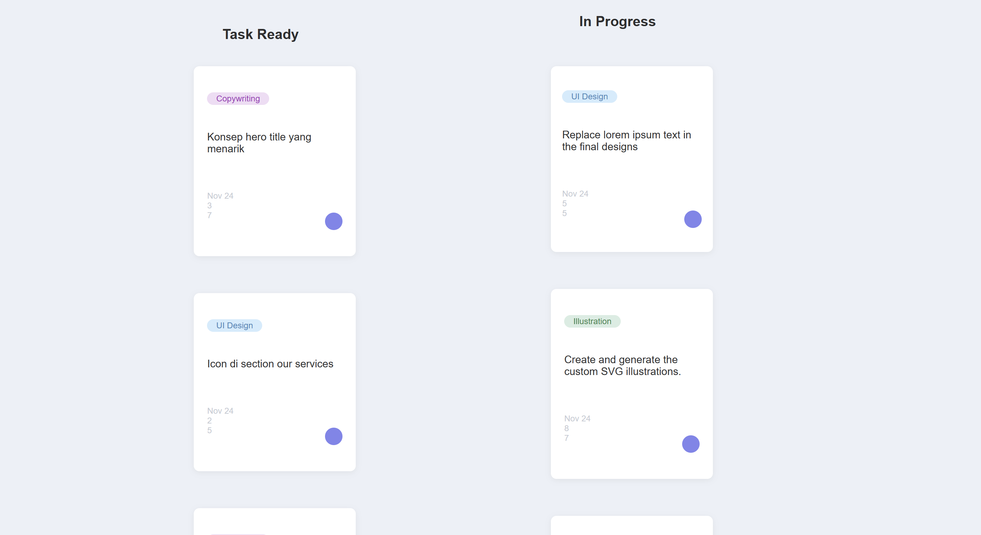
STICKY
TO-DO LIST

Slide 17
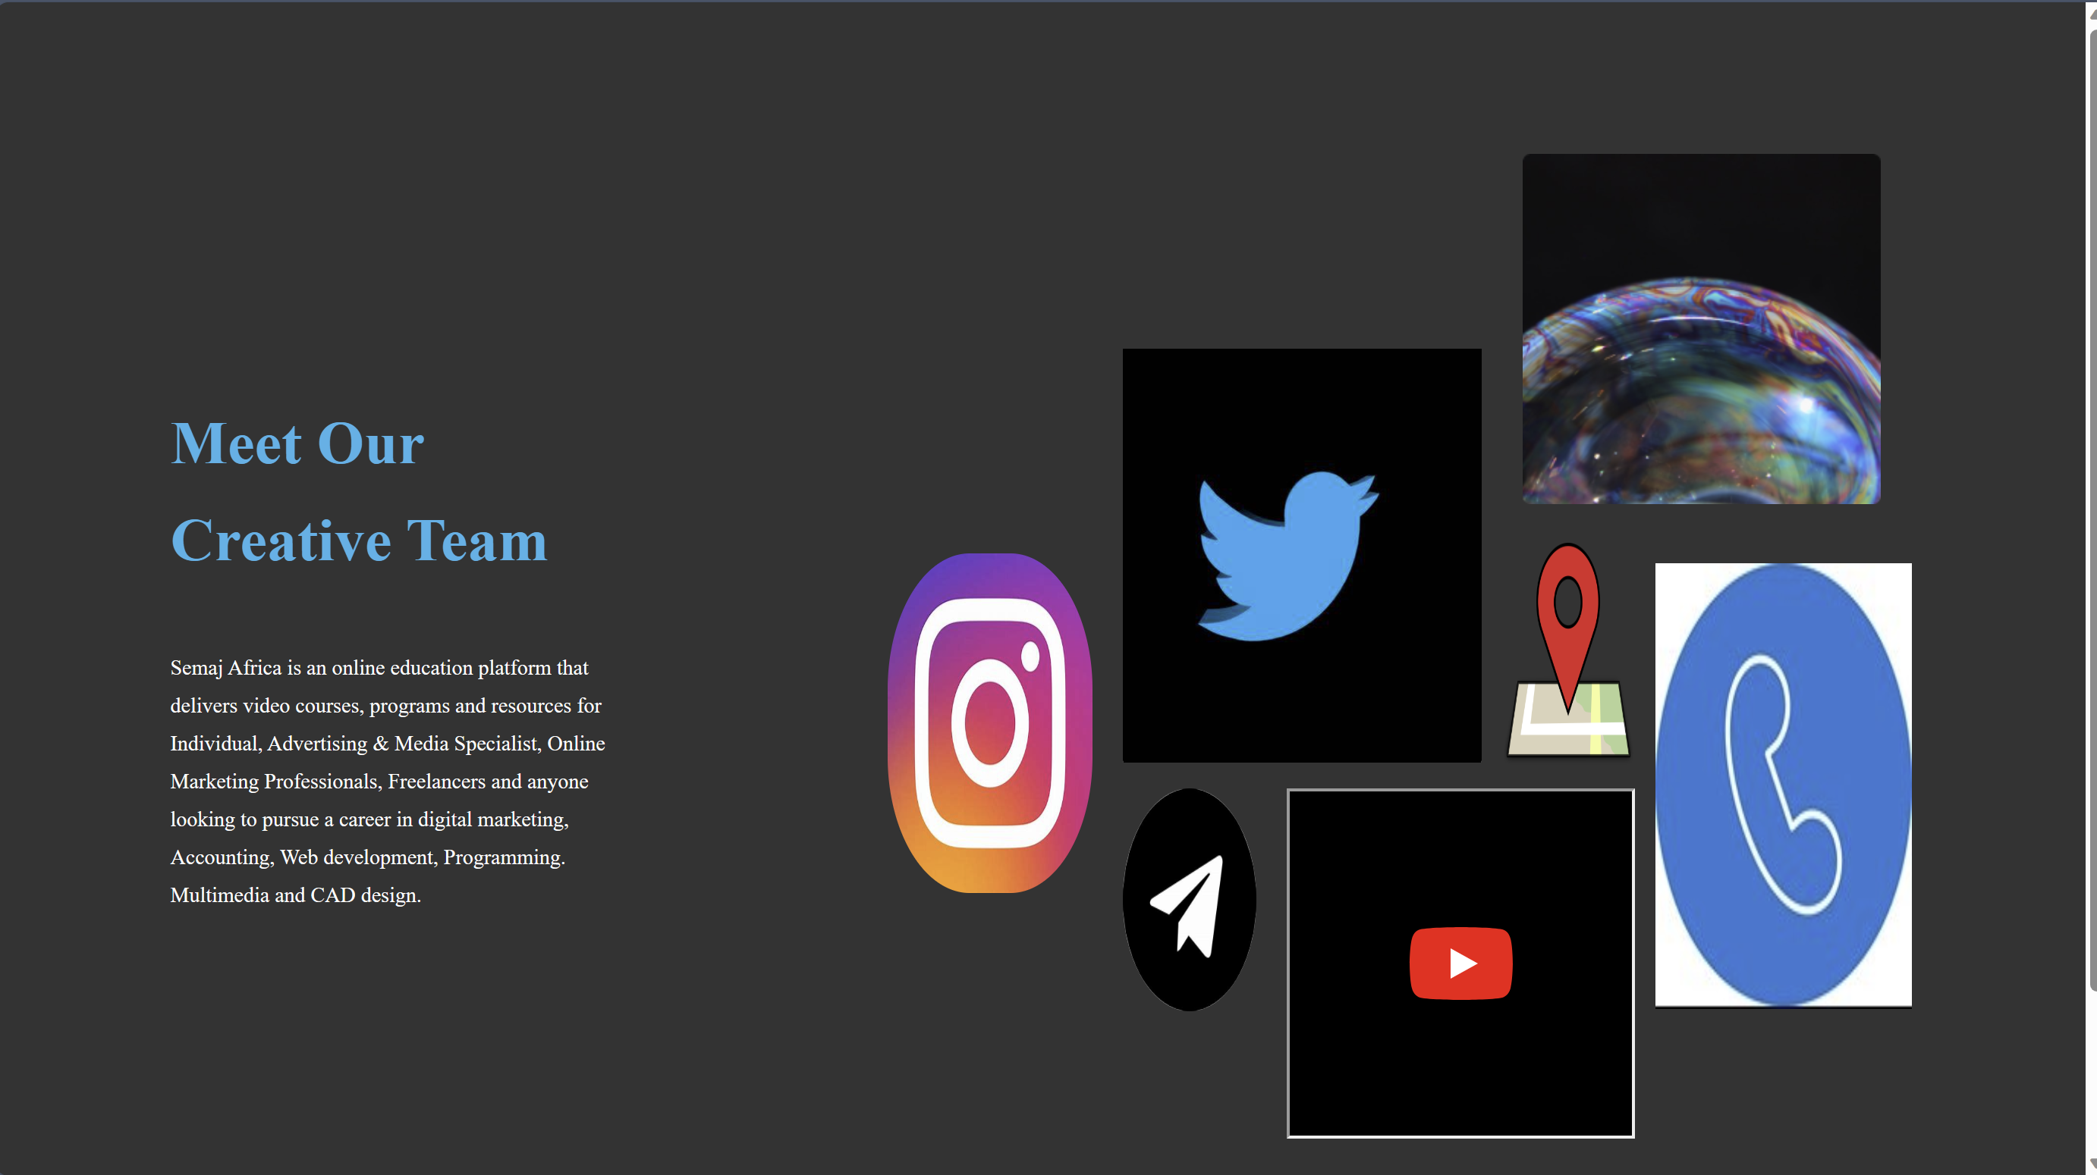
ABOUT US

Slide 18
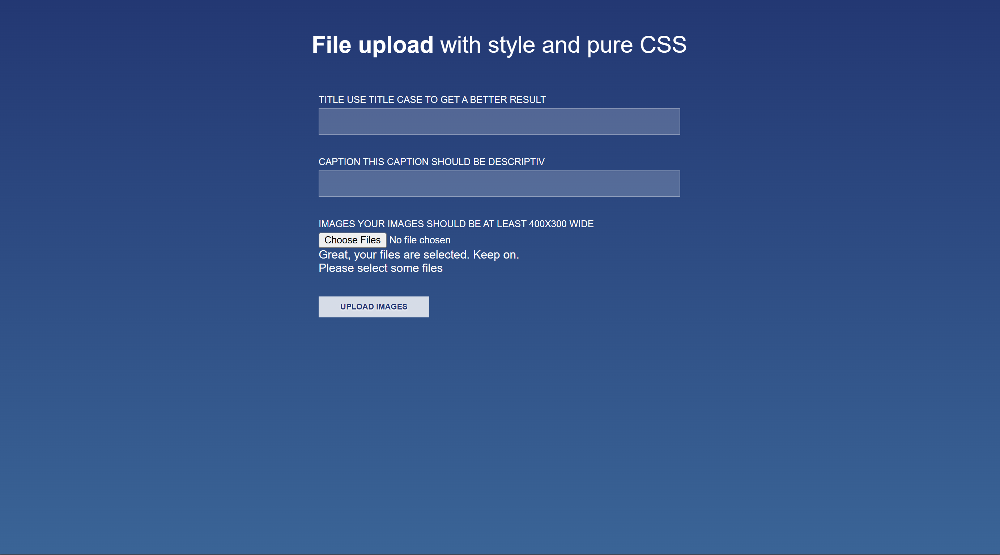
COMPLAINT PAGE

Slide 19


BUSINESS-CARD
{Contact-Card}

Slide 20
References/Links used
LINKS USED
Legacy Responsive Web Design Challenges | freeCodeCamp.org
CSS: Cascading Style Sheets | MDN (mozilla.org)
Sublime Text - Text Editing, Done Right
JavaScript Tutorial - Learn JavaScript (geeksforgeeks.org)
Learn CSS (web.dev)
RGB Color Codes Chart 🎨 (rapidtables.com)
REFERENCE’S BOOK
Web Development & Design Foundations with HTML5
Author: Terry Felke-Morris
HARTRON WEB-DESIGINING
Author: Hartron
Learning PHP,Javascript,CSS & HTML5
Author: Robin Nixon

Slide 21
Conclusion
In this presentation, we explored the process of creating a basic to-do list using HTML.
We discussed how HTML provides the structural foundation for organizing tasks in a clear and readable manner.
Key elements such as unordered lists (<ul>), list items (<li>) were used to construct the to-do list.
While HTML specifies the structure, we pointed out that JavaScript is generally used for interactive features like task modification. We also underlined the value of accessibility and briefly discussed CSS's function in styling. Overall, using HTML to create a to-do list is a key part of building a website and lays the groundwork for more advanced web-based task management systems.
Moreover we also introduced a new concept in To-Do list, normally if we wanted to insert a link in a list it will store as a text not as link.
But in our project if we wanted to store the link in the list it will store but not in text form it will become a click-able link into the list

Slide 22


